Slide 1
Introduction
lucas@ict.usc.edu

Slide 2

Course Logistics
Dr. Gale Lucas, lucas@ict.usc.edu
https://www.flickr.com/photos/hellocatfood/10545396704

Slide 3


Class Materials
Include:
Syllabus
Class lectures/powerpoints
Project part 1-3 assignment sheets
Use D2L
Please do not distribute any materials outside of class
https://commons.wikimedia.org/wiki/File:Presentation_icon_BLACK-01.png#/media/File:Presentation_icon_BLACK-01.png
https://commons.wikimedia.org/wiki/File:Ar_Icon_Article.svg#/media/File:Ar_Icon_Article.svg

Slide 4
Grading
Project: 90%
Midterm quiz: 5%
Final quiz: 5%

Slide 5

Office Hours by appointment
On Zoom
Send email to schedule

Slide 6
Contact
lucas@ict.usc.edu
TAs:
Premankur Banerjee premankur.banerjee@usc.edu
Bryan Moore
bryanjmo@usc.edu

Slide 7
Intro Lecture
https://www.flickr.com/photos/hellocatfood/10545396704

Slide 8
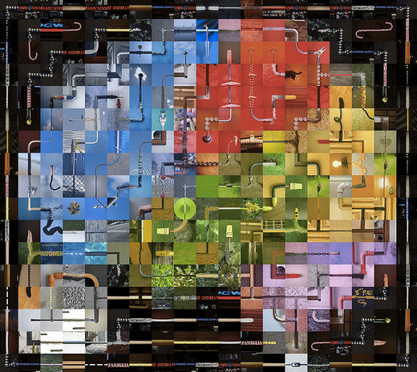
Some Important Terms
Data
Data quality
Data cleaning
Raw data
Privacy and sensitive data
Induction vs deduction
Causality
https://www.flickr.com/photos/genista/3432987963

Slide 9

What is Data
Data is information that is processable by computer:
information is in digital form
A program can read and analyze the information
https://www.flickr.com/photos/hellocatfood/10545396704

Slide 10
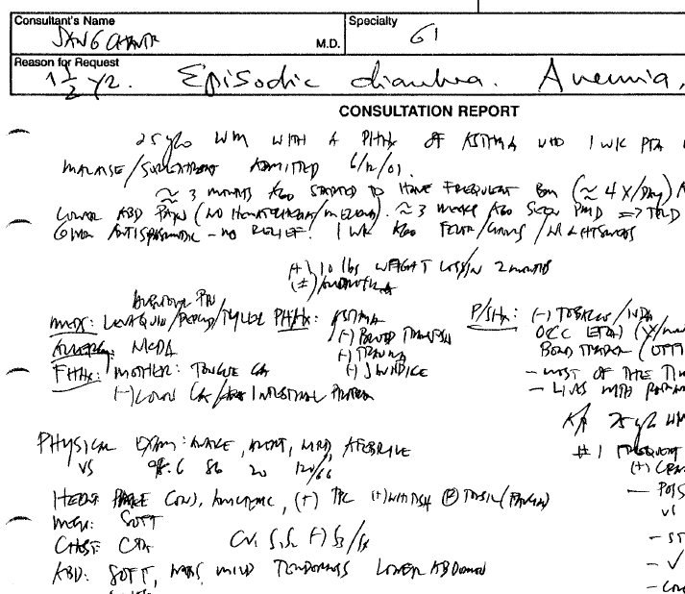
Is This Data?
Notes:
Is what is contained here Data? (because the image itself could be data)

Slide 11
Is This Data?
http://diyehr.com/making-your-electronic-health-records-searchable/

Slide 12
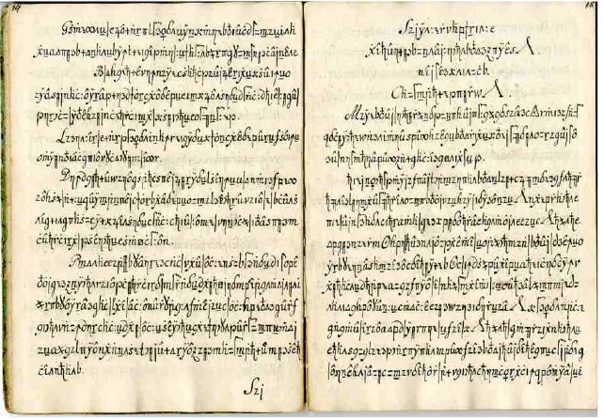
Is This Data?
http://stp.lingfil.uu.se/~bea/copiale/
Notes:
1760-1780

Slide 13
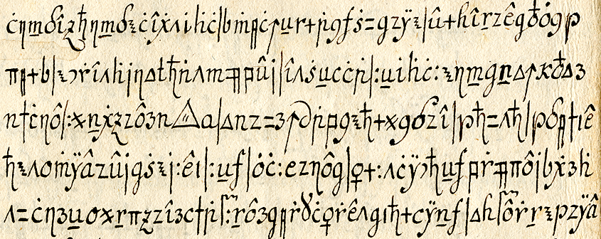
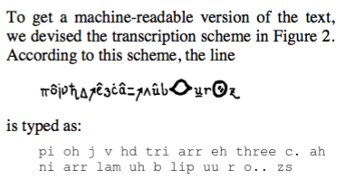
Is This Data?
http://stp.lingfil.uu.se/~bea/copiale/
Notes:
1760-1780

Slide 14
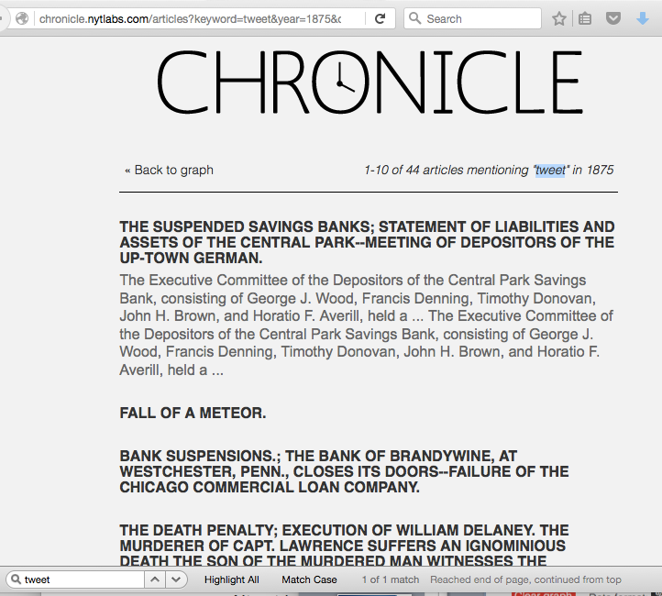
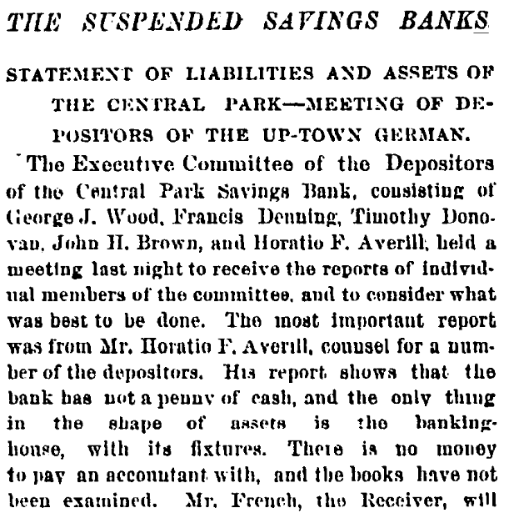
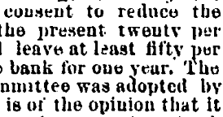
Data Quality
http://query.nytimes.com/mem/archive-free/pdf?res=9D01EFD91F3AEF3BBC4950DFB467838E669FDE

Slide 15
Data Cleaning
Course ID | Faculty Name | Semester Offered | Open
549 | A. Gold | Fall 2015 | Yes
533 | D. Garcia | Spring 2015 | Open
556 | P. Peters | Spring 2015 | Y
521 | J. Smith | Fall 2017 | Open
Joseph Smith or Jane Smith?
Errors (maybe)
Inconsistent formats

Slide 16
Data Cleaning to the Extreme…
Patient ID | Age | Smoker?
549 | 45 | Occasionally as a teen
533 | 55 | Never before lunch
556 | 43 | Two packs a day
521 | 78 | Quit 3 years ago
Requires a lot of work to be usable
Notes:
Free response data might not have been intended (e.g. here, a nurse just wrote down – should have “yes or no” and frequency and when started), but it can be intended: qualitative data!
We are talking about quantitative data in this class, and making qualitative data into quantitative data – but researchers in some fields do use qualitative data …

Slide 17
Raw Data
Newly collected data before cleaning or pre-processing
Typically has errors and missing values, and may not be in a format that allows for merging with other data
Course ID | Students Registered | Semester Offered | Open
549 | 15 | Fall 2015 | Yes
533 | 50 | Spring 2015 | Open
556 | 200 |  | Y
521 | 5000 | Fall 2017 | Open
Notes:
How is the data quality of raw data (compared to cleaned data)?

Slide 18
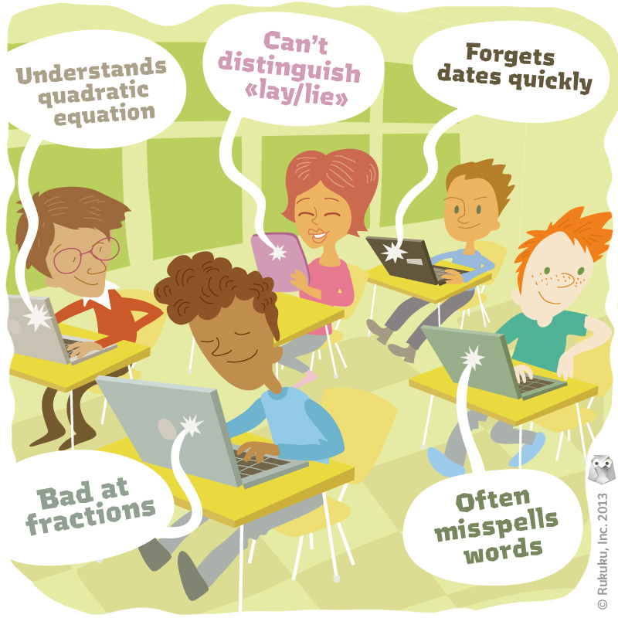

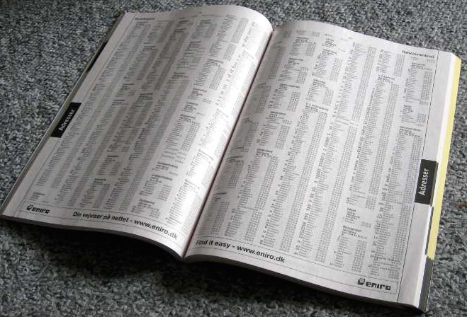
Privacy and Sensitive Data
http://www.rukuku.com/blog/wp-content/uploads/student-data-and-personalization.jpg
http://www.crimeoff24.com/?p=4869
https://en.wikipedia.org/?title=Telephone_directory#/media/File:Telefonbog_ubt-1.JPG

Slide 19

Deduction vs. Induction
Deduction uses theory to make hypotheses / predict outcomes, which can be tested (from general to specific, from theory to hypothesis)
Induction uses observations to infer general rules (from specific to general, from observation to theory)
“Top-down”
“Bottom-up”
Notes:
Deductive: USC students are hard working, Students in my class should be hard working; Inductive: Students in my class are hard working, USC students are hard working

Slide 20
Machine learning vs. other analyses
Classification
Assign a category (ie, a class) for a new instance
Clustering
Form clusters (ie, groups) with a set of instances
Pattern analysis
Identify regularities (patterns) in data
Simulation
Define mathematical formulas that can generate data similar to observed data
Null hypothesis testing
Identify relationship between independent and dependent variables

Slide 21
Causality
A variable v1 is a cause for variable v2 if changing v1 changes v2
A variable v3 is an effect of variable v2 if changing v3 does not change v2

Slide 22
Causality
To show evidence for causality empirically, it is best to run an experiment
Randomly assign participants to different conditions
Notes:
(eg therapy: doing therapy vs not/control condition)

Slide 23
First Assignment
https://www.flickr.com/photos/hellocatfood/10545396704

Slide 24
Project part 1
Someplace to start:
https://usc.qualtrics.com/jfe/form/SV_0e7lc1XgPENUvXf
https://oprs.usc.edu/education_certification/citi-faqs/

Slide 25
CITI
-For the training, please make sure you are registered with a free CITI account that is affiliated with USC. In order to avoid the paywall, go to www.citiprogram.org and click ‘Register’ in the far. -Beneath that, type “University of Southern California” into the “Select Your Organization Affiliation” section. -Check the boxes as they appear and then click the “Create Account” button on the left hand side. This should set you up with a free USC-affiliated account. The option should be accessible from there.
-You need to add a course to your account, from your main log-in page, scroll down to your affiliations. Next to University of Southern California, click the ‘View Courses’ button. On the new page, scroll down to the bottom of the page. In the grey box at the bottom, click the ‘Add Courses’ option.
-At the top of the page, CITI will ask you if you wish to take the course “COVID-19 Back to Campus (Fall 2020).” Select no.
-Under Question #2, select Human Subjects Research. -Proceed to Question #3 and select your Human Subjects Research training for UPC (main) campus. Please select the “Social/Behavioral” option. -Click ‘Submit,’ and you will be done adding courses.

